Slide 1
Pattern Recognition
Topic 1: Principle Component Analysis
Shapiro chap
Duda & Hart chap
Features
Principle Components Analysis (PCA)
Bayes Decision Theory
Gaussian Normal Density

Slide 2
Pattern Recognition Basics
input image/s
feature extraction
feature classification
pattern recognition results

Slide 3
Feature Extraction
Linear features
  eg. Lines, curves
2D features
eg. Texture
Feature of features

Slide 4
Feature Extraction
A good feature should be invariant to changes in
    scale
    rotation
    translation
    illumination

Slide 5
Feature Classification
Linear Classifier
Non-linear Classifier
  neural network

Slide 6
Pattern Recognition
Principle Components Analysis
(Karhunen-Loeve Transformation)
Principle components analysis and its interpretation
Applications

Slide 7
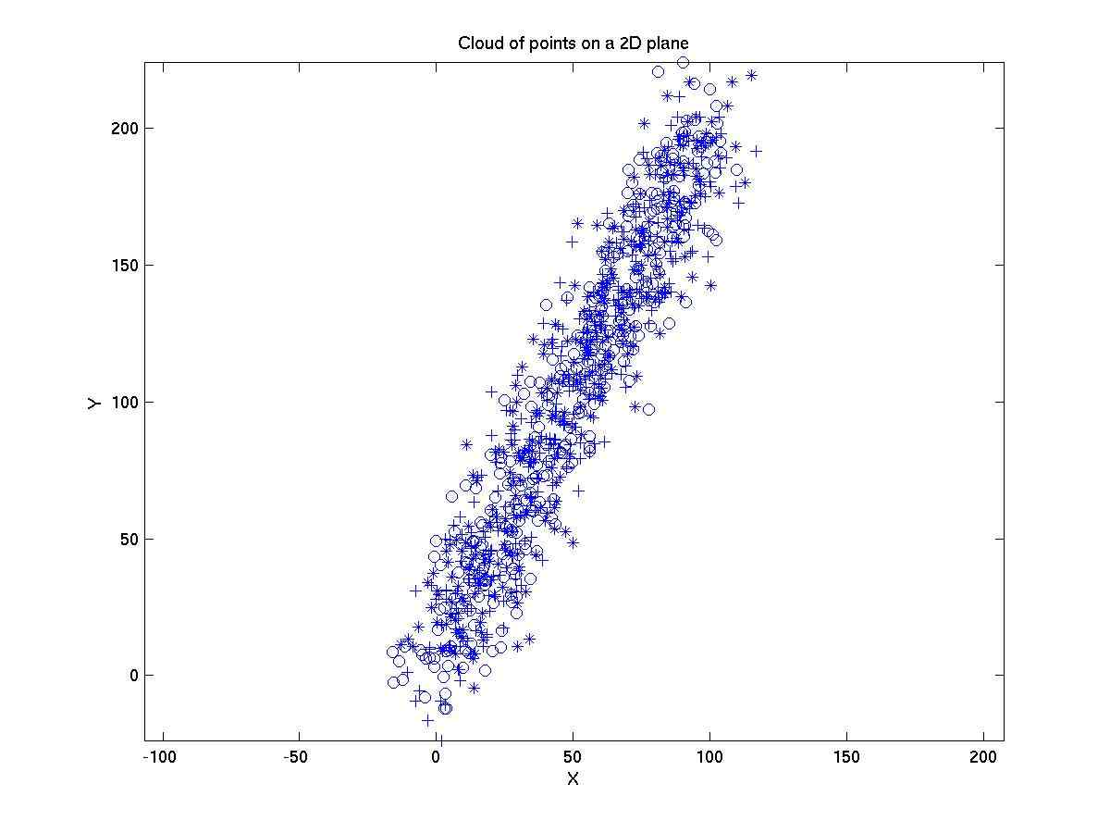
Suppose we are shown a set of points:

Slide 8
We want to answer any of the following questions:
What is the trend (direction) of the cloud of points
Which is the direction of maximum variance (dispersion)
Which is the direction of minimum variance (dispersion)
Supposing I am only allowed to use a 1D description
for this set of 2D points, i.e. using 1 coordinate instead of
2 coordinates (x,y). How should I represent the points
in such a way that the overall error is minimized ?
--- this is data compression problem
All these questions can be answered using
Principle Components Analysis (PCA)

Slide 9
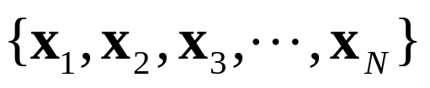
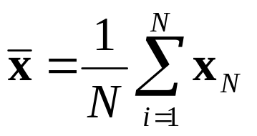
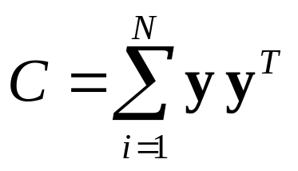
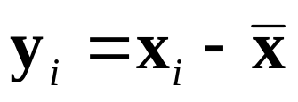
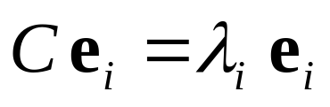


Principal Component Analysis (PCA)
Suppose we have N feature vectors
We take the mean of the feature vectors
Form the covariance matrix
where
Find the eigenvalues and eigenvectors of covariance matrix
where the
is a principal component with eigenvalue
We did all these in Lab 4 !

Slide 10

Shift cloud of points so that average position is at origin

Slide 11
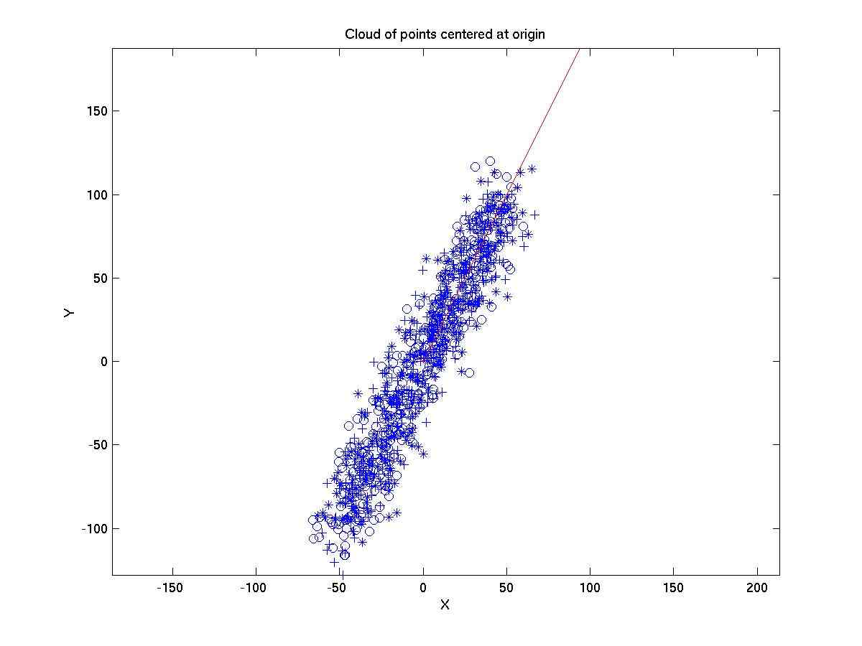
Principle components of cloud of points

Slide 12
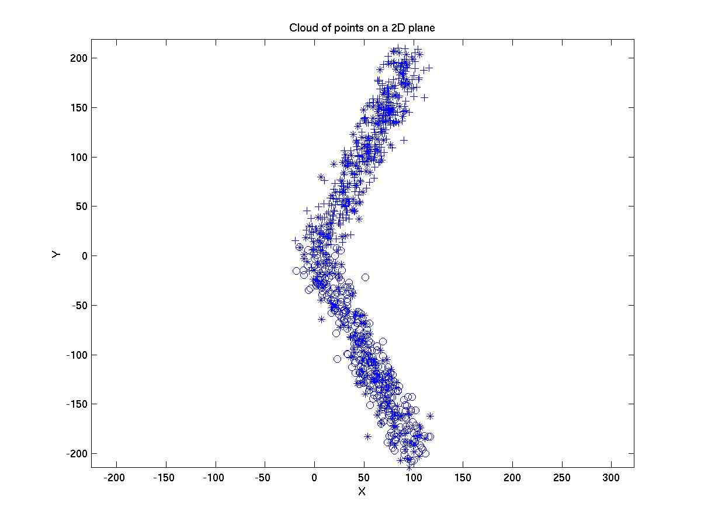
Another Example

Slide 13
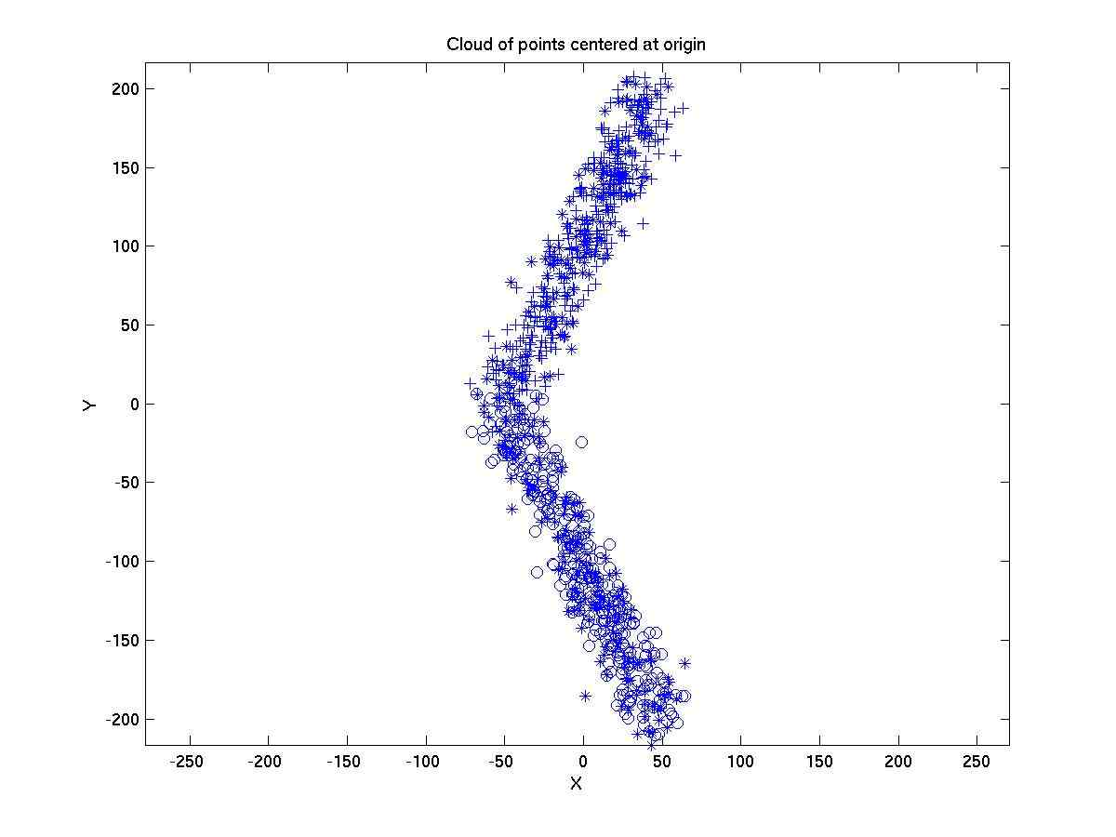
Shift cloud of points so that average position is at origin

Slide 14
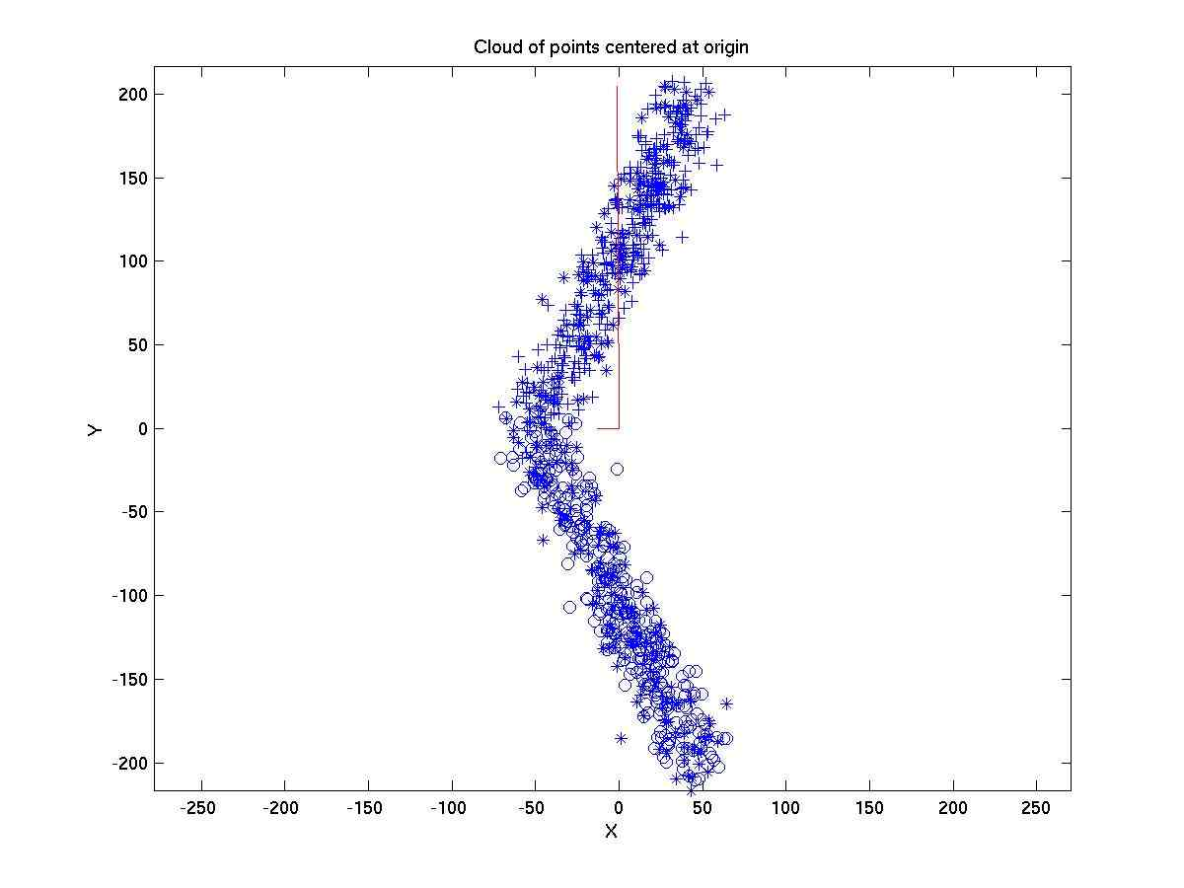
Principle components of cloud of points

Slide 15
One problem with PCA when applied directly to the covariance
matrix of the images is that the dimension of covariance matrix
is huge! For example, for a 256x256 image, X will be of dimension
65536x1. So the covariance matrix of X will be of size
65536x65536 !!! To compute the eigenvector of such a huge matrix
is clearly inconceivable.
To solve this problem, Murakami and Kumar proposed a technique in
the following paper:
Murakami, H. and Vijaya Kumar, B.V.K., “Efficient Calculation of
Primary Images from a Set of Images”, IEEE Trans. Pattern Analysis
and Machine Intelligence, vol. PAMI-4, No. 5, Sep 1982.
We shall now look at this method. In the lab, you will practice
implementing this algorithm for getting principle components from
huge feature vectors. We will use a face recognition example in the
lab.

Slide 16
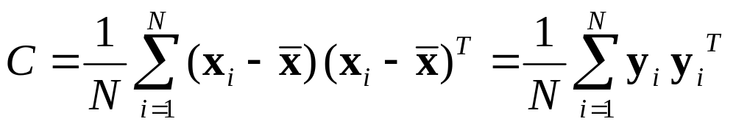

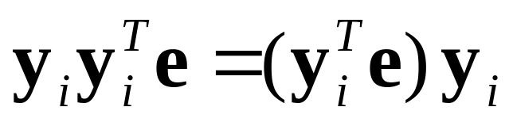
To begin, we note that our goal is to find the eigenvectors and
eigenvalues of the covariance matrix
We will see later that instead of working directly on , which is
a huge matrix, we can find the eigenvectors and eigenvalues of an
NxN matrix and then use it to deduce the eigenvectors and
eigenvalues of .
To see how this can be done, we first note that
scalar

Slide 17
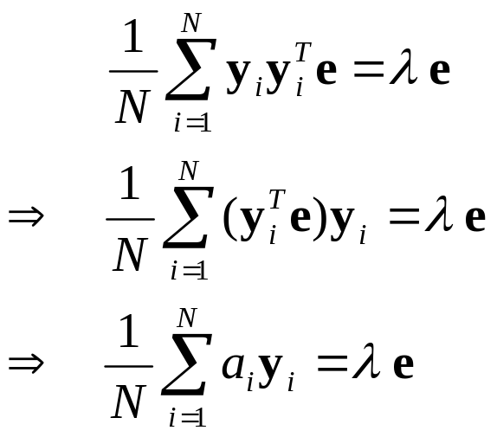
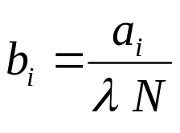
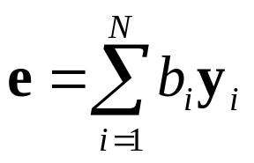


Therefore, if e is an eigenvector of C, then
Let
then
So if is an eigenvector of , can be expressed as a
linear combination of the vectors .

Slide 18
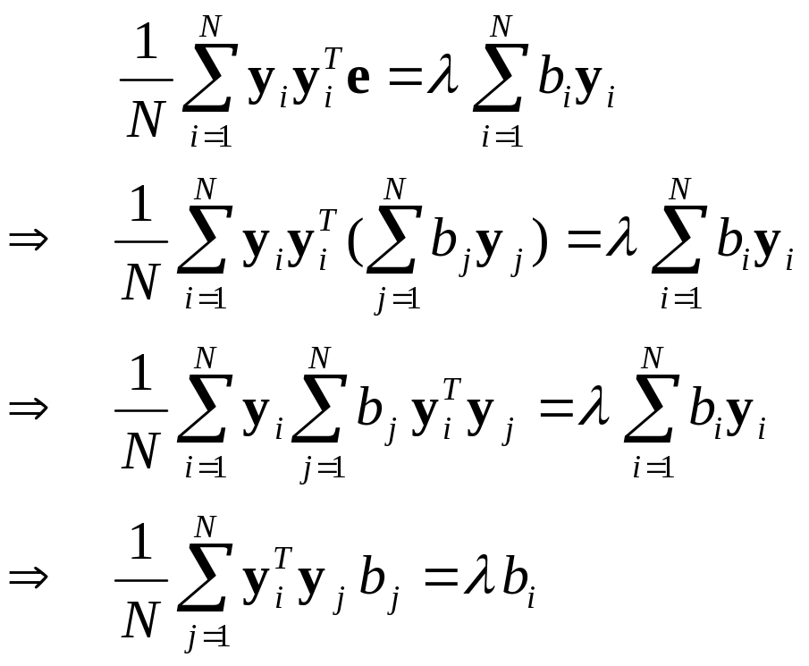
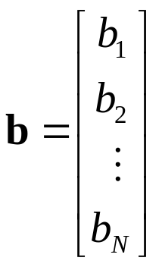
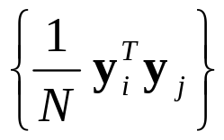
Therefore,
Therefore, the vector is the eigenvector of the matrix
with (i,j) elements given by

Slide 19
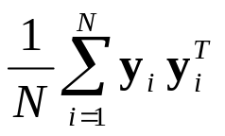
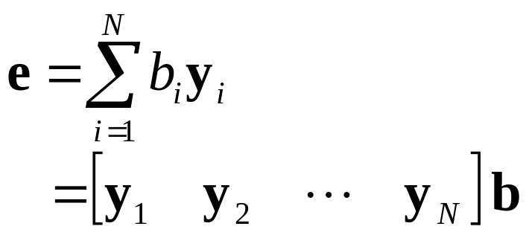
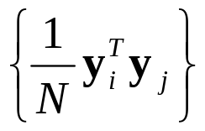

So the eigenvector of the matrix , i.e. e, is given by
Note that the eigenvalues of the matrix with elements
is the same as the eigenvalues of the matrix
In conclusion, the task of finding the eigenvectors of a huge matrix
of size x (where M is the number of pixels in an image),
is reduced to the task of finding the eigenvectors of a NxN matrix.

Slide 20



Summary
Suppose we have N feature vectors
We want to find the principle components. Since a direct
computation of covariance matrix is not feasible due to huge
dimension of covariance matrix, we do the following steps instead:
Step 1:
We take the mean of the feature vectors
Step 2:
Subtract the mean from each of the feature vectors

Slide 21
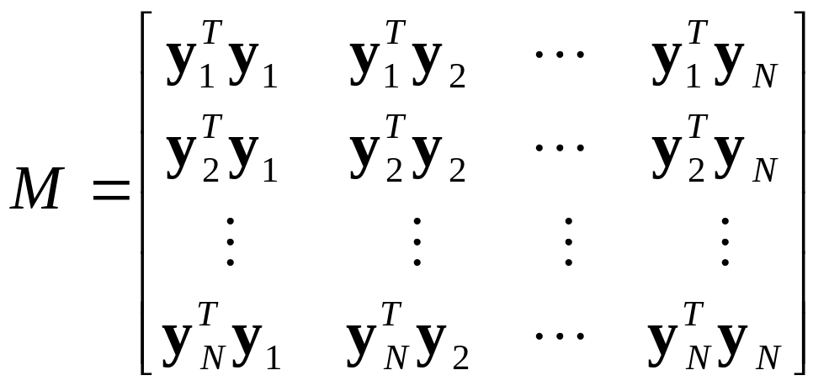
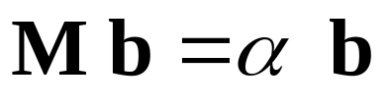
Step 3:
Form the inner product matrix
Step 4:
Find the eigenvectors and eigenvalues of M

Slide 22
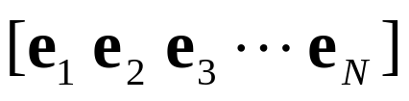
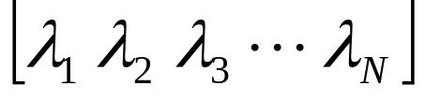
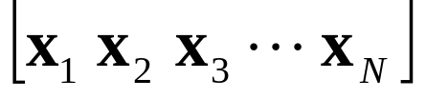
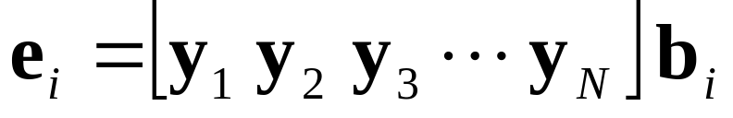
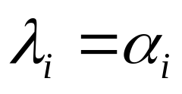
Step 5:
If and
are the principle components and the corresponding
eigenvalues respectively of
then

